Slide 1

Practical Consideration of SAFETY

Slide 2
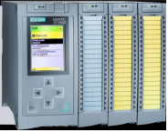
Safety PLC
It is a PLC dedicated for mission critical or safety-related application
High availability (Certified to certain safety integrity level - SIL)
Enhanced diagnostics capability
Supports multiple E-Stop Zones
Specific programming blocks for safety applications usually available (depending on vendor)
Shorten the programming complexity
Note: if you use SAFETY PLC it does not mean you comply to the SIL requirement till your programming comply to the safety requirement (not covered in this module).

Slide 3
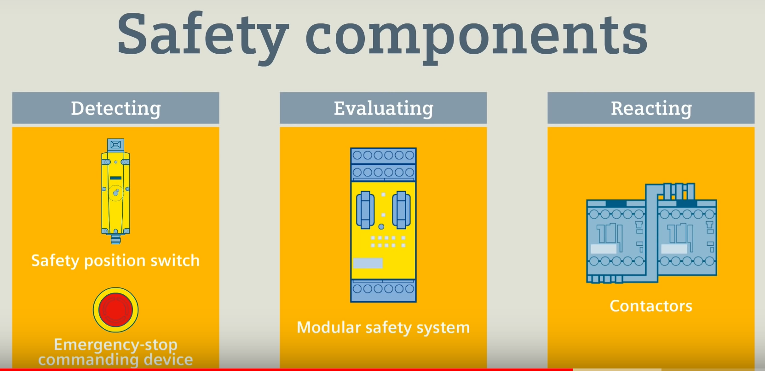
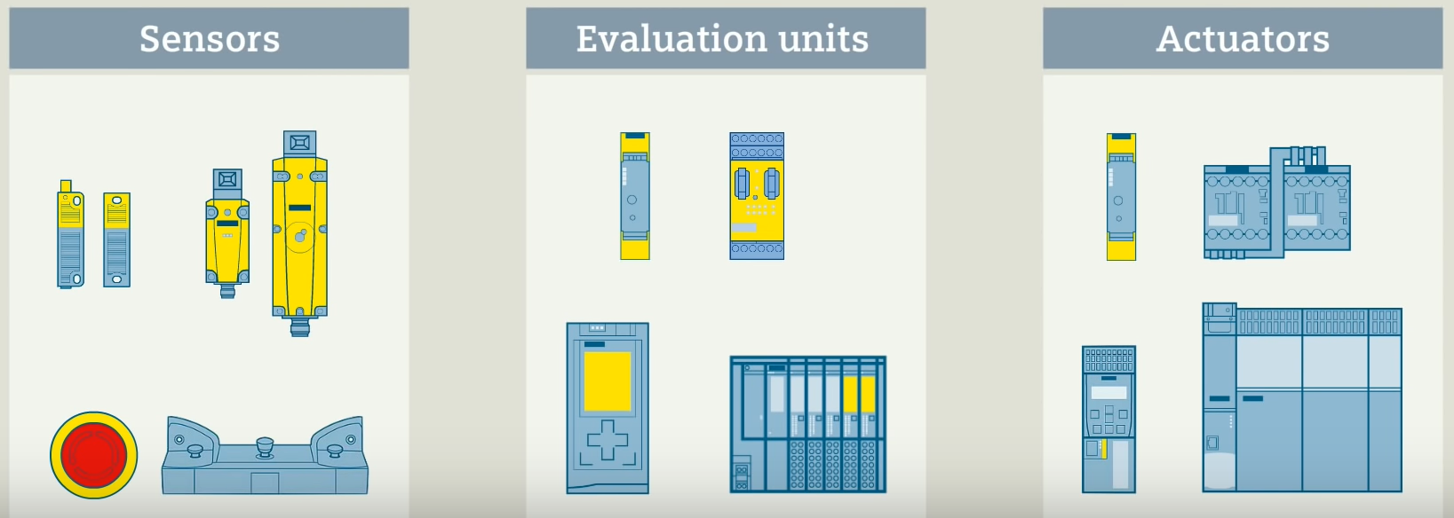

Slide 4
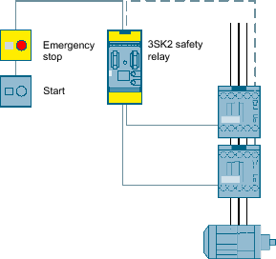
Emergency stop shutdown with Safety Relay
The safety relay monitors the E-stop command. When E-stop command is actuated, the safety relay opens the enabling circuits and switches the power contactors off in a safety-related way. If the E-stop command is unlatched, the feedback circuit is closed. Start button can be used to switch on again.
Notes:
https://support.industry.siemens.com/cs/document/109479271/emergency-stop-shutdown-to-sil-3-or-pl-e-with-a-3sk2-safety-relay?dti=0&lc=en-WW

Slide 5
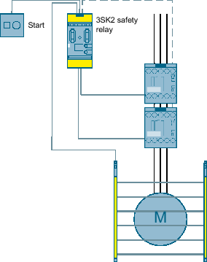
Access monitoring using a light curtain with safety relay
Monitor open danger zone, non-contact protective equipment such as light curtain used. If light beam is interrupted, initiates shut down
Notes:
The light curtain consists of a send unit and a receive unit. Between the two is the protective zone. If the light beam is interrupted, outputs OSSD1 and OSSD2 carry voltage and are evaluated by the safety relay. When the light beam is interrupted, the two outputs switch off and the safety relay opens the enabling circuits, switching off the power contactors in a safety-related manner.
https://support.industry.siemens.com/cs/document/109479277/access-monitoring-using-a-light-curtain-to-sil-3-or-pl-e-with-a-3sk2-safety-relay?dti=0&lc=en-WW

Slide 6
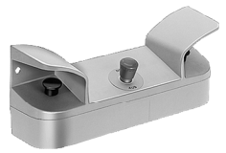
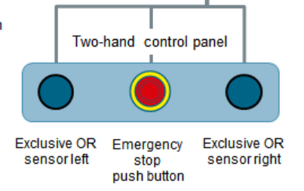
Two-Hand Control Panel with Integrated Emergency Stop
Two-hand controls are widely used in the industrial field. The desired action is started only by the simultaneous pressing of both push buttons of the two-hand control panel.
Notes:
Fields of application include pressing, spot welding, punching and print finishing or wood working
https://support.industry.siemens.com/cs/document/21331100/safety%3A-two-hand-control-panel-with-integrated-emergency-stop-in-ple-sil-3?dti=0&lc=en-WW

Slide 7
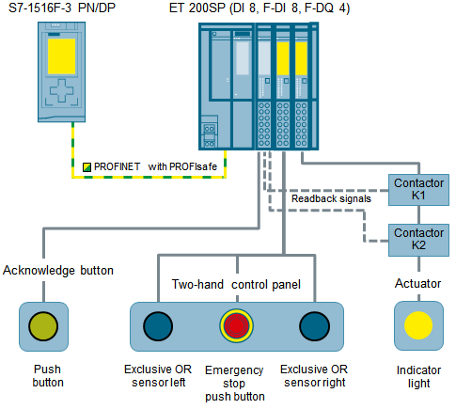
Two-Hand Control Panel with Integrated Emergency Stop
Example with failsafe PLC S7-1516F-3 programmed with functional sequence. Remote IO, ET200SP connected to the contactors and associated buttons

Slide 8
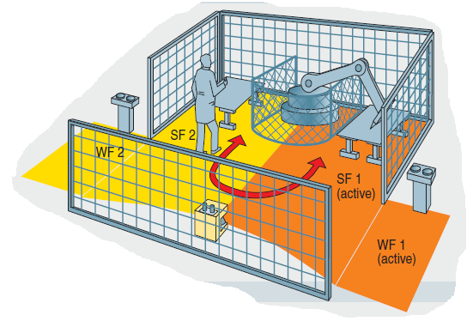
Safety Laser Scanner with Monitoring
An assembly cell with a robot has two workstations that can alternately be freely accessed by an operator. During operation, the situation changes due to the movement of the robot: The hazardous area becomes the working area and vice versa.
Notes:
Case 1: While the robot works at station 1, the operator can load or unload at station 2.
Case 2: While the robot works at station 2, the operator can load or unload at station 1

Slide 9
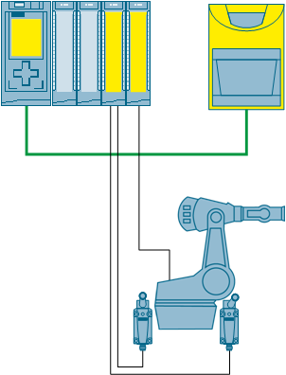
Safety Laser Scanner with Monitoring
Safety PLC
Laser Scanner
communicate via PROFINET
The laser scanner monitors a danger area, depending on the robot’s position, and shuts down its safe OSSD output (Output Signal Switching Device) upon entering the protective field, which causes the PLC to shut down the robot.
The robot’s position is detected via two sensors
Notes:
https://support.industry.siemens.com/cs/document/58804919/safety-laser-scanner-with-monitoring-case-switching-on-an-s7-1500?dti=0&lc=en-WW

Slide 10
Safety Design Risk Reduction
Safe Design
Technical Measures
User Information

Slide 11
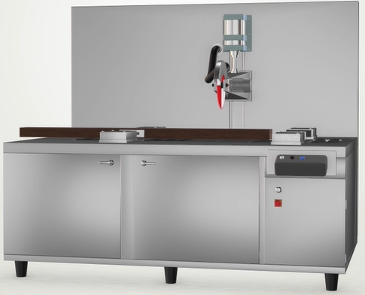
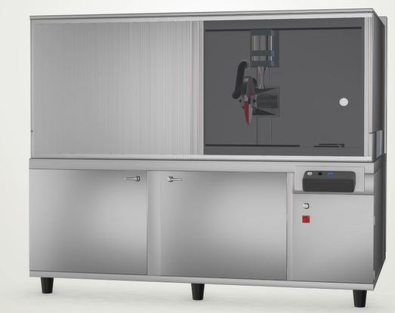
Safe Design
Exposed cutting blade is NOT safe
Add enclosure with viewing window sliding door
Is this design safe enough?
Would operator get injury when the door is open?
If it is safe, process stops here.
Else, Technical Measure shall be implemented

Slide 12
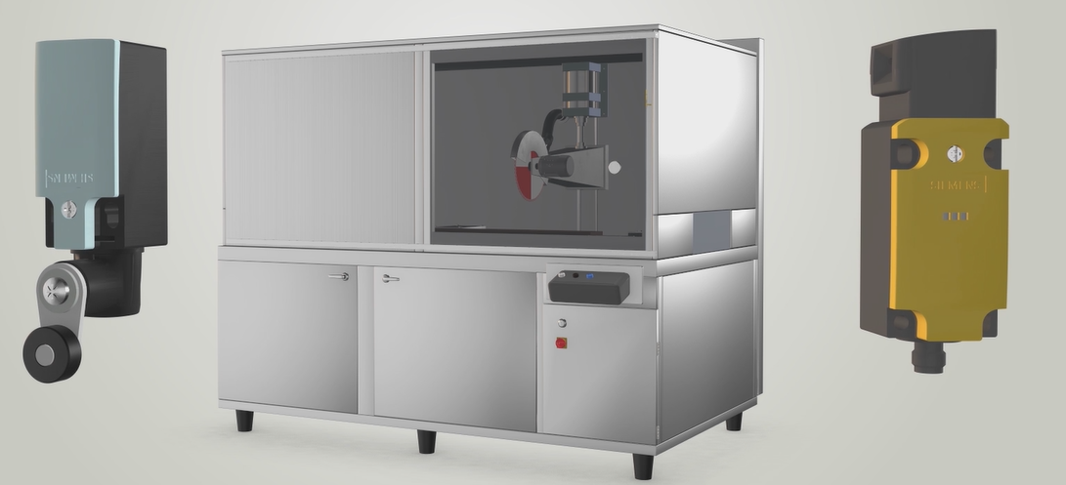
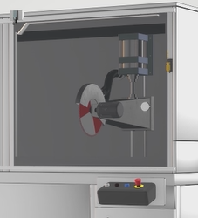
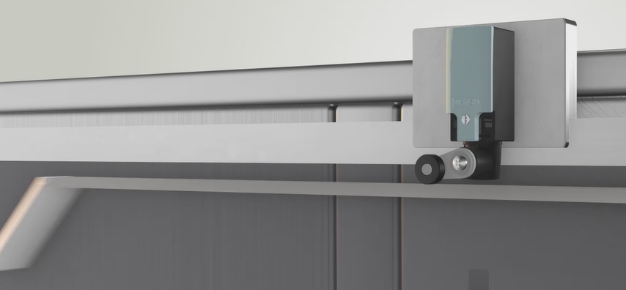
Technical Measures
Viewing windows to be monitored by switches
Operator E-Stop
In this case, all technical measures are
Implemented all other residual risk.
Notes:
1. Viewing windows to be monitored by switches – Stop cutting when door is open
2. Operator E-Stop – Stop process regardless of door position

Slide 13
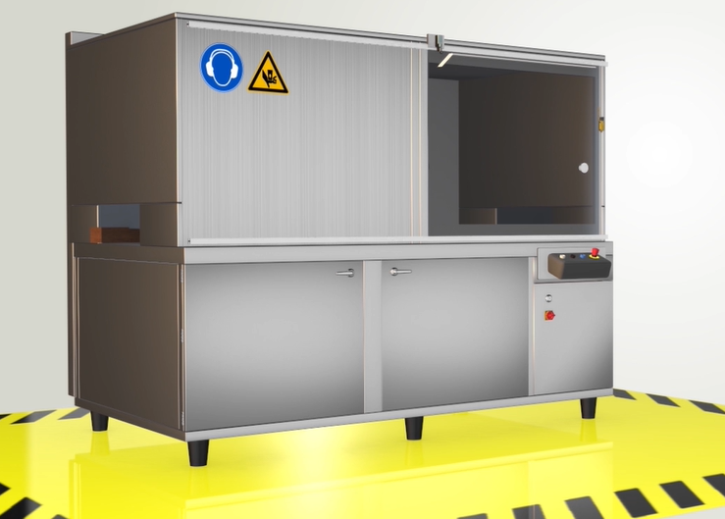
User Information
PPE Required
Identification
Safety Clearance
Safety Clearance

Slide 14
What have you learnt?
Interlock and Thermal overload
Interlock ensure mutually exclusive functionality
Thermal overload cut off the load when it exceed current limit
Master Control Relay
Cut of power to I/O or circuit under emergency condition
Safety Components
Detecting – switches or sensors
Evaluating – Safety relay or PLC
Reacting – Actuator or contactors
Safety Design Risk Reduction
Safe Design
Implement Technical Measures
Include User Information

Slide 15

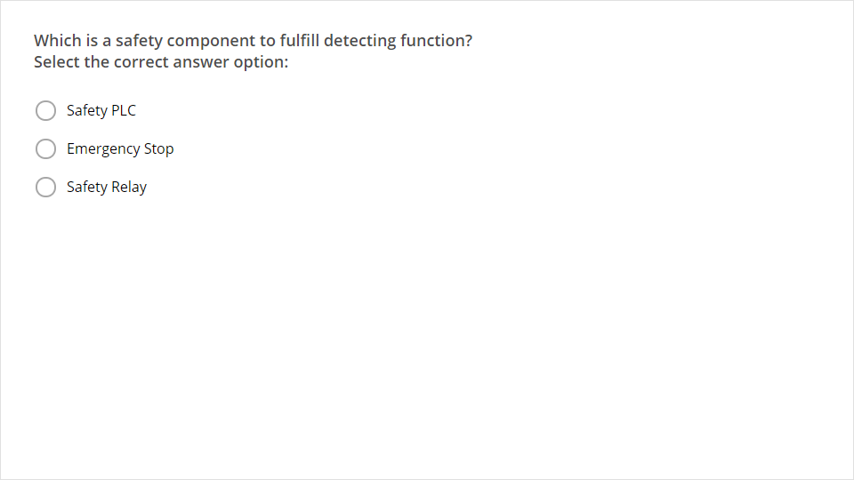
Quiz
Click the Quiz button to edit this object

